Slide 1
Legaltap mini project: final review
d. Vignesh - 21p71a62a0 l. s. Shreyas - 21p71a6280
p. Uday Kumar - 21p71a6291 v. Uday Kiran – 21p71a6290
Project guide: Mrs. Sridevi (asst. prof.)

Slide 2
About the project
We are developing a keylogger for the mini-project.
A keylogger is an application/tool which records every keystroke on a computer or a device in which it’s currently executing.
We have named it “LegalTap”.

Slide 3
Overview of Keyloggers
Keyloggers are hard to detect, as well as difficult to prevent.
Keyloggers are of different types: software keylogger, hardware keylogger, and remote access keylogger.
The keylogger’s purpose is actually monitoring & troubleshooting. However, it is used for malicious activities by cybercriminals. Cybercriminals use keyloggers to steal sensitive information, which is later used to launch an actual attack.

Slide 4
Key areas covered
Keylogger : spreading and risks.
Working and operations.
Legal compliance.
Administrating a legal keylogger.

Slide 5
How existing keyloggers work?
They capture keystrokes via “event listeners”, at the operating system level.
The captured keystrokes are stored in a log file, which is mostly hidden and can be accessed remotely later or in real-time.
They can literally capture any key which is tapped on the keyboard.
Some advanced keyloggers are invisible to malware detection systems and the log files will be cleverly disguised to avoid suspicion.

Slide 6
Disadvantages of existing system
Privacy violations : unauthorized access to personal data breaches.
Security risk : stolen credentials lead to identity theft and financial frauds.
Hard to detect : advanced keyloggers run invisibly, bypassing antivirus programs.
Performance issues : continuous monitoring may slow down devices.

Slide 7
Proposed system
GOAL : develop a secure keylogging application.
The keylogger is secure and legalized due to it’s given administrative access. The keylogging is controlled by the administrator of the organization.
The log file is encrypted and can be only accessed by administrator, and only is allowed to view it.
The keylogger notifies the user when keylogging has started.

Slide 8
Advantages of the proposed system
Transparency : employees know when the keylogging is in progress. They can temporarily pause keylogging if feel an urge for some privacy.
Legality : the proposed keylogger can be deployed without any legal complications.
Optimized for performance : the keylogger uses minimum system resources, which doesn't affect the performance of the device.

Slide 9
Disadvantages of existing system
Privacy violations : unauthorized access to personal data breaches.
Security risk : stolen credentials lead to identity theft and financial frauds.
Hard to detect : advanced keyloggers run invisibly, bypassing antivirus programs.
Performance issues : continuous monitoring may slow down devices.

Slide 10
Advantages of the proposed system
Transparency : employees know when the keylogging is in progress. They can temporarily pause keylogging if feel an urge for some privacy.
Legality : the proposed keylogger can be deployed without any legal complications.
Optimized for performance : the keylogger uses minimum system resources, which doesn't affect the performance of the device.

Slide 11
Research on keyloggers
Studies highlight that keyloggers are a common vector for cyberattacks. They often spread through phishing mails, drive-by downloads or by exploiting a vulnerability.
Cybersecurity journals discuss methods to detect and block keyloggers using antivirus tools and behavioral analysis.
Keyloggers are capable of secretly sending the captured keystrokes to the cybercriminal who devised it.

Slide 12
Legal & ethical perspectives
Various laws around the world regulate unauthorized keylogging.
Ethical dilemmas arise when keyloggers are used for legitimate surveillance.
Consent is a big consideration when it comes to legitimate surveillance. Employers may have the right to monitor employee activity on company devices, but this can be subject to controversy.
The use of keyloggers should be proportionate to the risk it’s intended to address. If risk is relatively low, justifying keylogger is an over-statement.

Slide 13
architecture
A High level architecture design

Slide 14
INPUT CAPTURE MODULE
Interfaces with the system’s keyboard drivers to intercept keystrokes.
Works in background without disrupting system processes.
PROCESSING LAYER
Filters, processes, formats raw keystrokes for readability.
Maps special keys like Enter, Shift, Ctrl, and function keys.
DATA STORAGE AND ENCRYPTION
Logs the captured data into a secure file or database.
Uses encryption to prevent unauthorized access to logs.

Slide 15
algorithms
The software’s working principle

Slide 16
KEYSTROKE CAPTURE ALGORITHM
Detect keystrokes using Pynput in Python.
Detect key press events and log the associated key values.
SPECIAL KEYS MAPPING
Identify and replace special keys codes (e.g., 0x0D for Enter, 0x20 for Space) with readable text labels.
DATA ENCRYPTION ALGORITHMS
Encrypt logs using AES
Ensure secure storage and transmission of logs.

Slide 17
Modules and their descriptions
Basic information about the modules used

Slide 18
KEY CAPTURE MODULE
Binds with the physical keyboard to capture keystrokes.
Captures all keystrokes in real-time.
LOG FORMATTER MODULE
Converts raw keystrokes into human-readable format.
Handles newline character, tab spacing and backspace corrections.
STORAGE MODULE
Save formatted logs to secure file.
Implements encryption for added security.
USER INTERFACE MODULE (ADMINISTRATOR ONLY)
Provides dashboard for configuring settings, viewing logs, and enabling/disabling the keylogger.

Slide 19
Functioning of the modules
Details about the modules used

Slide 20
Keystroke capture module
The keystroke capture module is the module which implements the keylogging feature.
It captures the keystrokes and sends them the log formatter module.
It captures the keystrokes in the form of characters and sends them one-by-one.
It will keep capturing keystrokes until the software exits.

Slide 21
Log formatter module
The log formatter module is the module which stores the keystrokes in a log file.
This module takes input from keystroke capture module, and converts it into a string form and sent to storage module.
Other special keys like Shift, Ctrl, Alt are modified accordingly.
The Tab key, Scroll lock, Num lock will be ignored. The Function keys, Navigation keys and keys with alternate functions will be logged accordingly.

Slide 22
Storage module
The storage module is the module which creates the log file and stores the keystrokes in it.
This module writes the keystrokes in the log file after encrypting them.
Then the log file is also encrypted at the end.

Slide 23
User interface module
This is an exclusive part of the software which can only be accessed by the administrator of the company’s network administrator.
The administrator is the only one who can configure the keylogger, view logs, enable or disable the keylogger.
The administrator is solely responsible for the functioning of the keylogger. The admin has the credentials to control the keylogger.

Slide 24
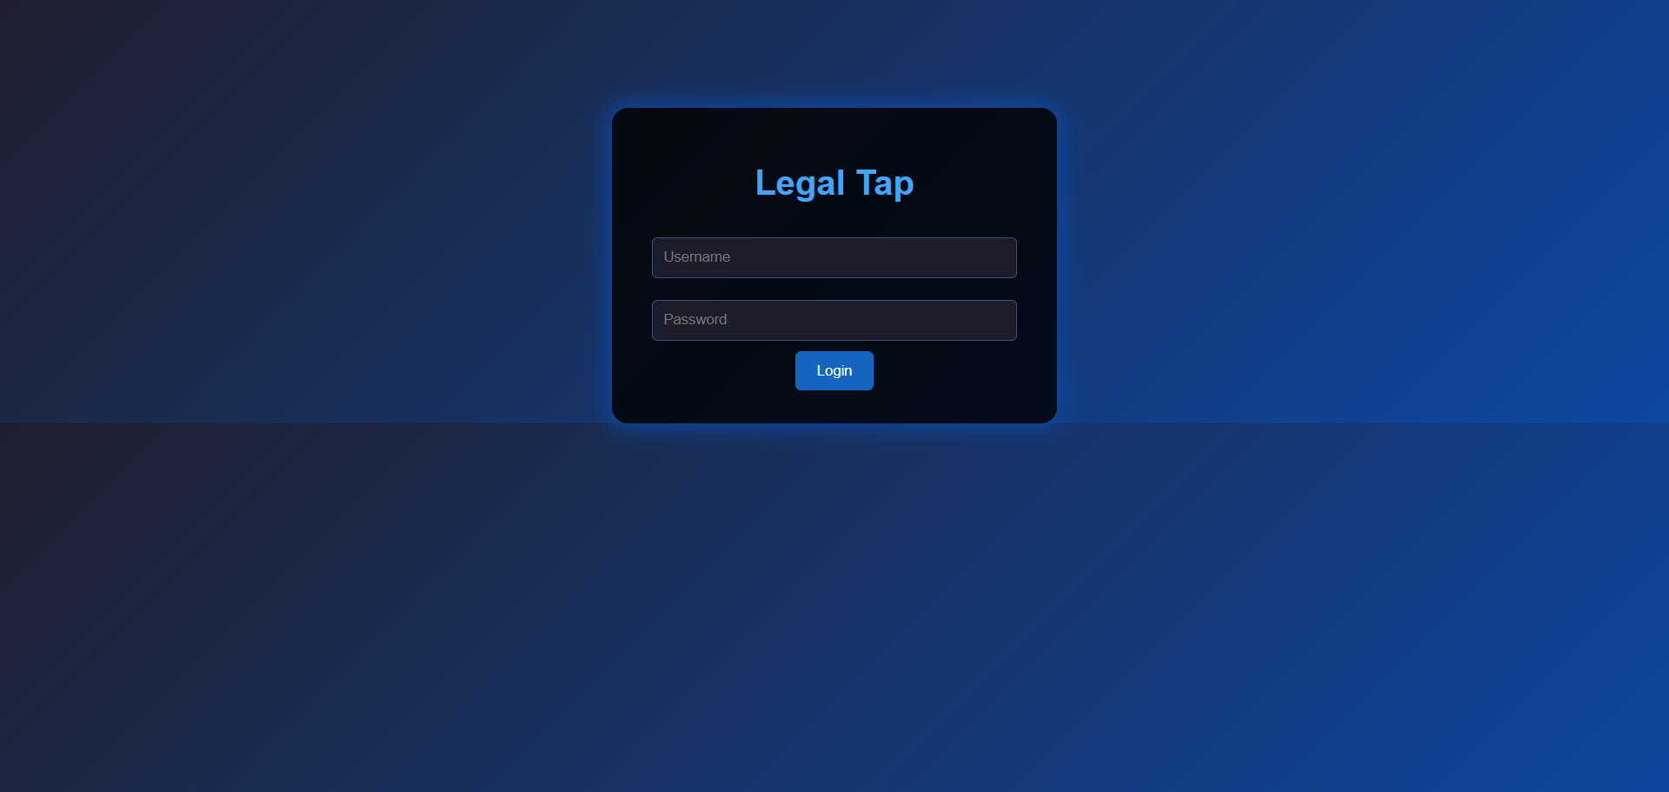
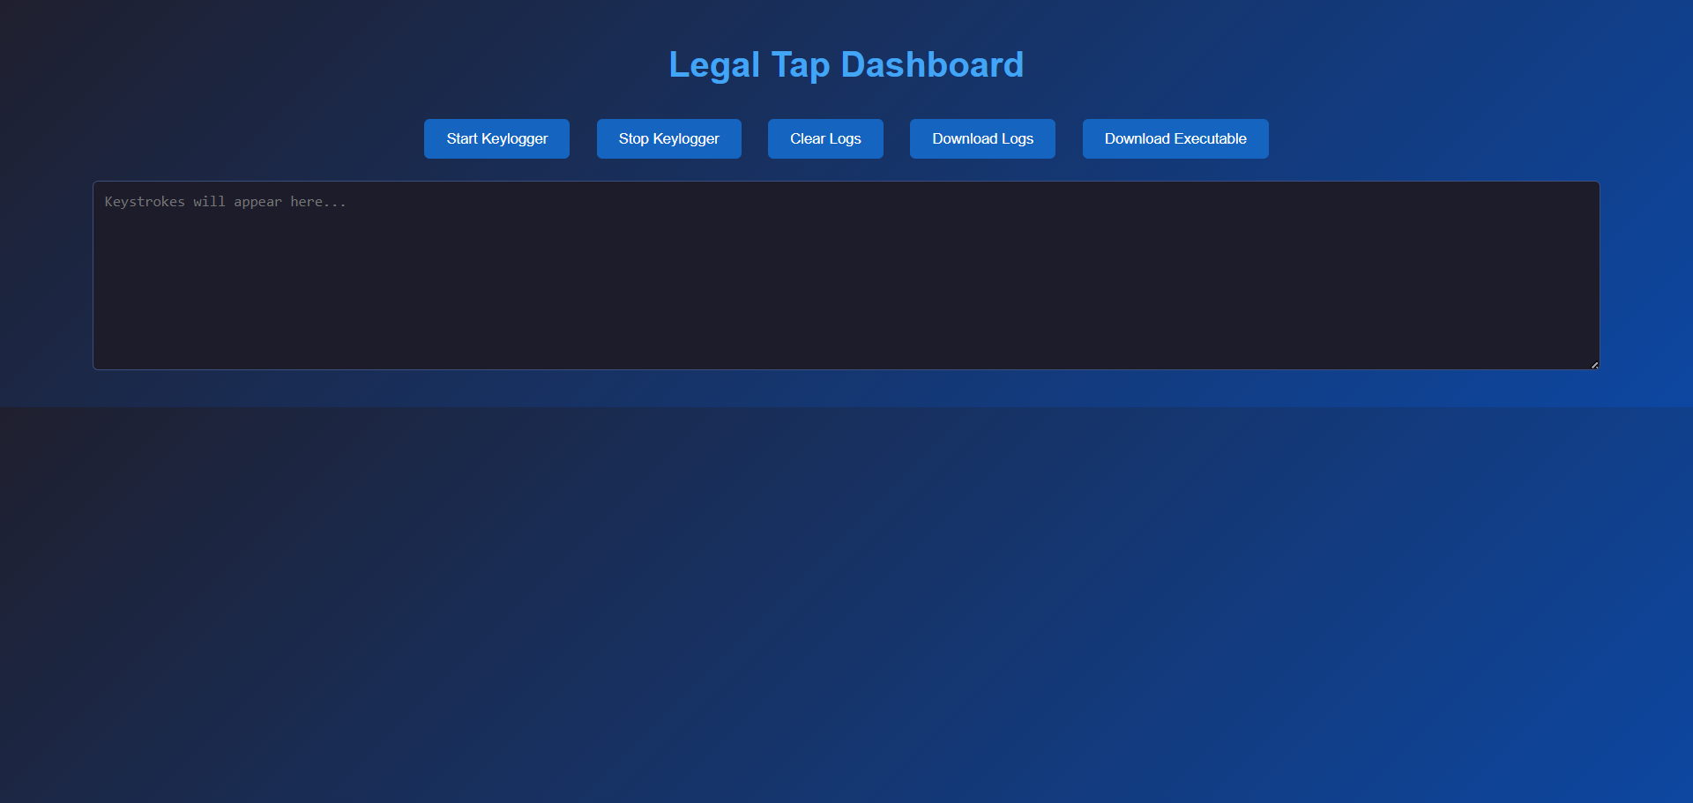
Execution screenshots

Slide 25
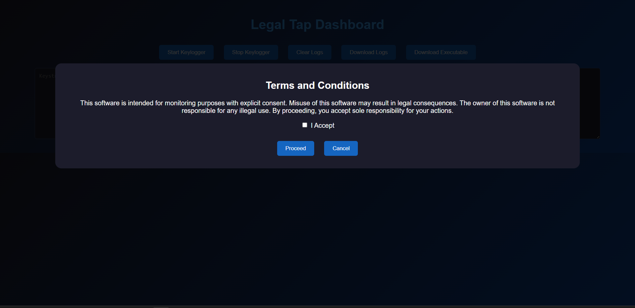
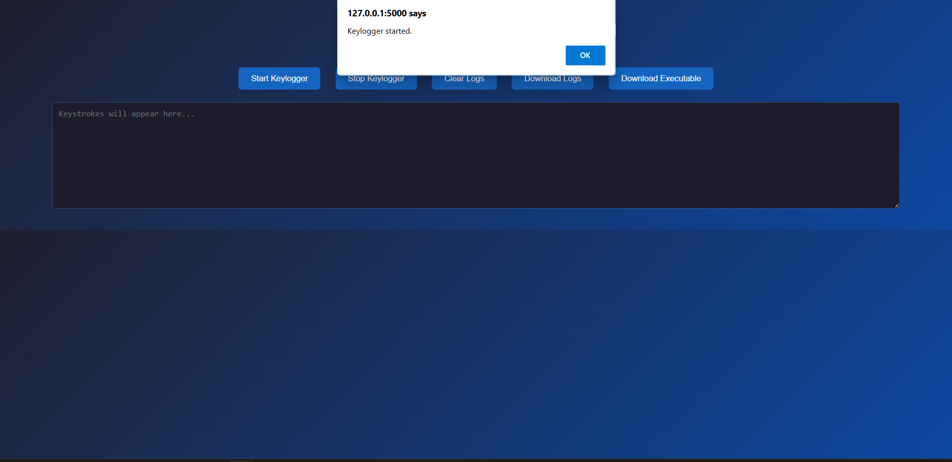
Execution continued

